Slide 1
Graph Algorithms
Bairi Sahitya
Loh Xin Yi
Satini Sankeerthana
Shauna Tan Li-Ting
Ong Li Wen

Slide 2
AGENDA
01
04
02
05
03
06
MULTI SOURCE BFS I
TIME COMPLEXITY II
To find the nearest Hospital
Worst Case Time Complexity Analysis
TIME COMPLEXITY I
TEST CASE
Worst Case Time Complexity Analysis
Example Graph
MULTI SOURCE BFS II
EMPIRICAL ANALYSIS
To find the K-nearest Hospitals
Statistics

Slide 3
MULTI SOURCE BFS I
To find the nearest Hospital

Slide 4
MULTI SOURCE BFS I
Is based on the Breadth-First Search (BFS) Algorithm except:
Multiple BFS traversals concurrently.
Instead of one source being pushed into the queue, all the source nodes are pushed into the queue.

Slide 5
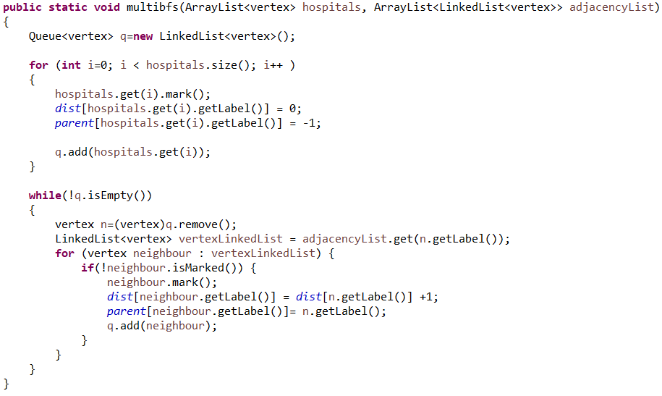
MULTI SOURCE BFS I

Slide 6
Data Structures used: 1D Arrays
Distance Array: stores the distance to nearest hospital
0 | 1 | 2 | 3 | 4 | 5 | 6 | 7 | 8 | 9
x | 0 | x | 1 | x | x | 2 | x | 3 | x
Parent Array: stores the node id of predecessor
0 | 1 | 2 | 3 | 4 | 5 | 6 | 7 | 8 | 9
x | -1 | x | 1 | x | x | 3 | x | 6 | x
shortest distance from node 8: 3
8 → 6 → 3 → 1

Slide 7
TIME COMPLEXITY ANALYSIS
Worst Case:
Each edge is processed exactly once : ϴ(|E|)
Each node is queued and dequeued exactly once: ϴ(|V|)
Adjacency list used → complexity of getting neighbours: O(1)
ϴ(|V|+|E|)

Slide 8
MULTI SOURCE BFS II
To find the K-nearest Hospital

Slide 9
MULTI SOURCE BFS II
To find the Kth nearest hospital, MS BSF is still used, however there are a few modifications:
At each iteration instead of a node being pushed into the queue, a pair of vertices are pushed into the queue (N,H).
The node- source pair is added to the queue if the node is visited less than k times and if the source is not among the nearest hospitals already computed for that node.
Hospital is marked within the node object when the shortest distance is computed.
Counter nRemoved is incremented every time a node is removed from the queue.
Modifications in the structure of the Distance and Parents Array
Notes:
The first node in the pair is the node to be explored while the second node is the nearest source (hospital node).
4. This allows the algorithm to get the row of the predecessor to add to the node and the respective distance to use.

Slide 10
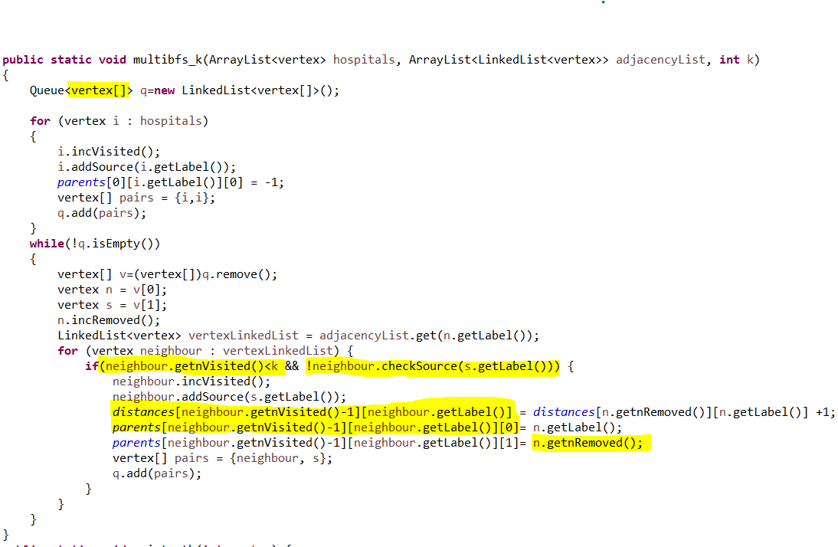
MULTI SOURCE BFS II
Notes:
The first node in the pair is the node to be explored while the second node is the nearest source (hospital node).
4. This allows the algorithm to get the row of the predecessor to add to the node and the respective distance to use.

Slide 11
Data structures used: 2D Array
Distances Array: stores the distance to kth nearest hospital
0 | 1 | 2 | 3 | 4 | 5 | 6 | 7 | 8 | 9
distance to nearest hospital
x | 0 | x | 1 | x | x | 2 | x | 3 | x
distance to second nearest hospital
x | x | x | x | x | 2 | x | x | x | x
distance to third
nearest hospital
x | x | x | x | x | x | x | x | x | x
What is the shortest distance from Node 5 to the second nearest hospital?
X - distance
Notes:
=eg: if 2nd row then the values in the second row is the distance from that node to the 2nd nearest hospital
We have multiple rows to store the distance to the k nearest hospital eg: 2nd row is for the second nearest hospital

Slide 12
Data structures used: 3D Array
Parents Array: stores the node id of predecessor and the row to look for the nth nearest hospital
0 | 1 | 2 | 3 | 4 | 5 | 6 | 7 | 8 | 9
x | [-1][0] | x | [1][0] | x | x | [3][0] | x | [6][0] | x
x | x | x | x | x | [3][0] | x | x | x | x
Shortest path node 5 to the second nearest hospital?
5 → 3 → 1

Slide 13
TIME COMPLEXITY ANALYSIS
Worst Case:
Each edge is processed exactly k-times : ϴ(k|E|)
Each node is queued and dequeued exactly k-times: ϴ(k|V|)
Adjacency list used → complexity of getting neighbours: O(1)
Complexity of the additional computations: O(1)
ϴ(k(|V|+|E|))

Slide 14
TEST CASE
Example Graph

Slide 15
0
1
4
2
3
13
9
Legend
8
5
Building
10
7
6
Hospital
NodeID for Nodes 11 and 12 do not exist

Slide 16
EMPIRICAL ANALYSIS
Statistics

Slide 17
EMPIRICAL ANALYSIS
Same graph was used for all tests (1000 nodes)
Same set of hospital IDs were used for each number of hospitals across all levels of k
To compare within each k, for each k:
Measured the time taken (ms) for each number of hospitals 30 times (sample size for each number of hospitals = 30)
Calculate the average time taken (ms) using the 30 readings for each number of hospitals
To compare between different values of k:
Calculate the total average time taken (ms) for all numbers of hospitals for each value of k

Slide 18
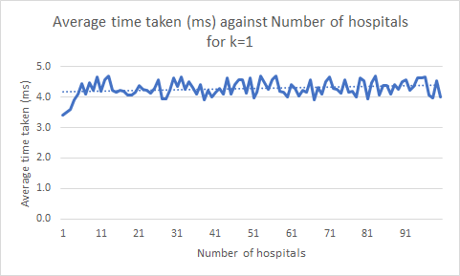
Comparing within same values of k
0 <= Number of hospitals <= 100
Sample size for each hospital size = 30
k=1

Slide 19
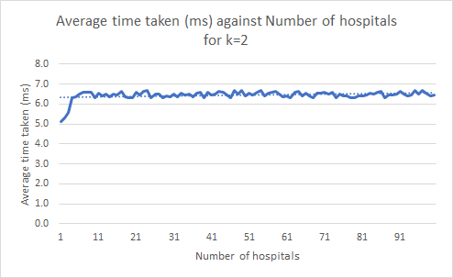
Comparing within same values of k
0 <= Number of hospitals <= 100
Sample size for each hospital size = 30
k=2

Slide 20
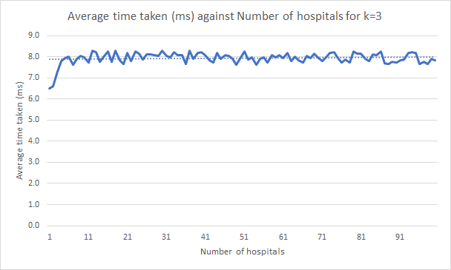
Comparing within same values of k
0 <= Number of hospitals <= 100
Sample size for each hospital size = 30
k=3

Slide 21
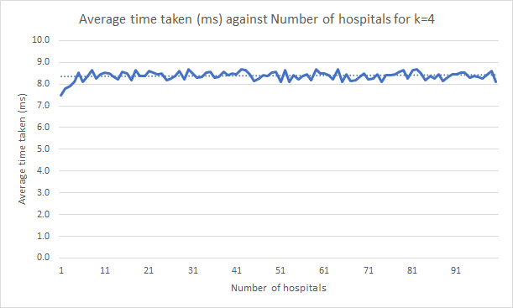
Comparing within same values of k
0 <= Number of hospitals <= 100
Sample size for each hospital size = 30
k=4

Slide 22
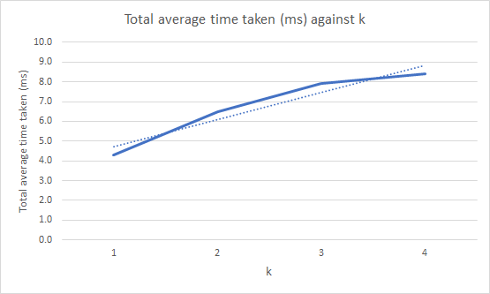
Comparing between different values of k

Slide 23
Thank You!
Any Questions?

